Slide 1
Data Analytics (CS3203N)
Lecture #5
Probability Distributions

Slide 2

Quote of the day..
"I avoid looking forward or backward, and try to keep looking upward."
Charlotte Bronte, an English novelist and poet

Slide 3
Today’s discussion…
Probability vs. Statistics
Concept of random variable
Probability distribution concept
Discrete probability distribution
Discrete uniform probability distribution
Binomial distribution
Multinomial distribution
Hypergeometric distribution
Poisson distribution

Slide 4
Today’s discussion
Continuous probability distribution
Continuous uniform probability distribution
Normal distribution
Standard normal distribution
Chi-squared distribution
Gamma distribution
Exponential distribution
Lognormal distribution
Weibull distribution

Slide 5
Just a minute to mark your attendance

Slide 6
Probability and Statistics
Probability is the chance of an outcome in an experiment (also called event).
Event: Tossing a fair coin
Outcome: Head, Tail
Probability deals with predicting the likelihood of future events.
Statistics involves the analysis of the frequency of past events
Example: Consider there is a drawer containing 100 socks: 30 red, 20 blue and 50 black socks.
We can use probability to answer questions about the selection of a
random sample of these socks.
PQ1. What is the probability that we draw two blue socks or two red socks from the drawer?
PQ2. What is the probability that we pull out three socks or have matching pair?
PQ3. What is the probability that we draw five socks and they are all black?

Slide 7
Statistics
Instead, if we have no knowledge about the type of socks in the drawers, then we enter into the realm of statistics. Statistics helps us to infer properties about the population on the basis of the random sample.
Questions that would be statistical in nature are:
SQ1: A random sample of 10 socks from the drawer produced one blue, four red, five black socks. What is the total population of black, blue or red socks in the drawer?
SQ2: We randomly sample 10 socks, and write down the number of black socks and then return the socks to the drawer. The process is done for five times. The mean number of socks for each of these trial is 7. What is the true number of black socks in the drawer?
etc.

Slide 8
Probability vs. Statistics
In other words:
In probability, we are given a model and asked what kind of data we are likely to see.
In statistics, we are given data and asked what kind of model is likely to have generated it.
Example 4.1: Measles Study
A study on health is concerned with the incidence of childhood measles in parents of childbearing age in a city. For each couple, we would like to know how likely, it is that either the mother or father or both have had childhood measles.
The current census data indicates that 20% adults between the ages 17 and 35 (regardless of sex) have had childhood measles.
This give us the probability that an individual in the city has had childhood measles.

Slide 9
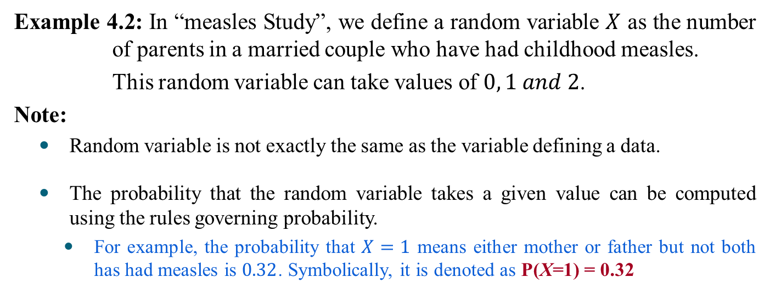
Defining Random Variable
Definition 4.1: Random Variable
A random variable is a rule that assigns a numerical value to an outcome of interest.
Example 4.2: In “measles Study”, we define a random variable $X$ as the number of parents in a married couple who have had childhood measles.
This random variable can take values of $0, 1 and 2$.
Note:
Random variable is not exactly the same as the variable defining a data.
The probability that the random variable takes a given value can be computed using the rules governing probability.
For example, the probability that $X=1$ means either mother or father but not both has had measles is $0.32$. Symbolically, it is denoted as P(X=1) = 0.32

Slide 10

Probability Distribution
Definition 4.2: Probability distribution
A probability distribution is a definition of probabilities of the values of random variable.
Example 4.3: Given that $0.2$ is the probability that a person (in the ages between 17 and 35) has had childhood measles. Then the probability distribution is given by
X | Probability
0 | 0.64
1 | 0.32
2 | 0.04
?

Slide 11
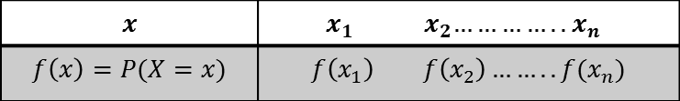
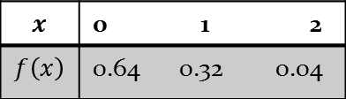
Probability Distribution
In data analytics, the probability distribution is important with which many statistics making inferences about population can be derived .
In general, a probability distribution function takes the following form
Example: Measles Study
$$x$$ | ${ x}_{1 } { x}_{2}…………..$ $x_{n}$
$$f\left(x\right)=P(X=x)$$ | $$f\left(x_{1}\right) f\left(x_{2}\right)…….. f(x_{n})$$
$$x$$ | 0 1 2
$$f\left(x\right)$$ | 0.64 0.32 0.04

Slide 12
Taxonomy of Probability Distributions
Discrete probability distributions
Binomial distribution
Multinomial distribution
Poisson distribution
Hypergeometric distribution
Continuous probability distributions
Normal distribution
Standard normal distribution
Gamma distribution
Exponential distribution
Chi square distribution
Lognormal distribution
Weibull distribution

Slide 13
Usage of Probability Distribution
Distribution (discrete/continuous) function is widely used in simulation studies.
A simulation study uses a computer to simulate a real phenomenon or process as closely as possible.
The use of simulation studies can often eliminate the need of costly experiments and is also often used to study problems where actual experimentation is impossible.
Examples 4.4:
A study involving testing the effectiveness of a new drug, the number of cured patients among all the patients who use such a drug approximately follows a binomial distribution.
Operation of ticketing system in a busy public establishment (e.g., airport), the arrival of passengers can be simulated using Poisson distribution.

Slide 14
Discrete Probability Distributions

Slide 15
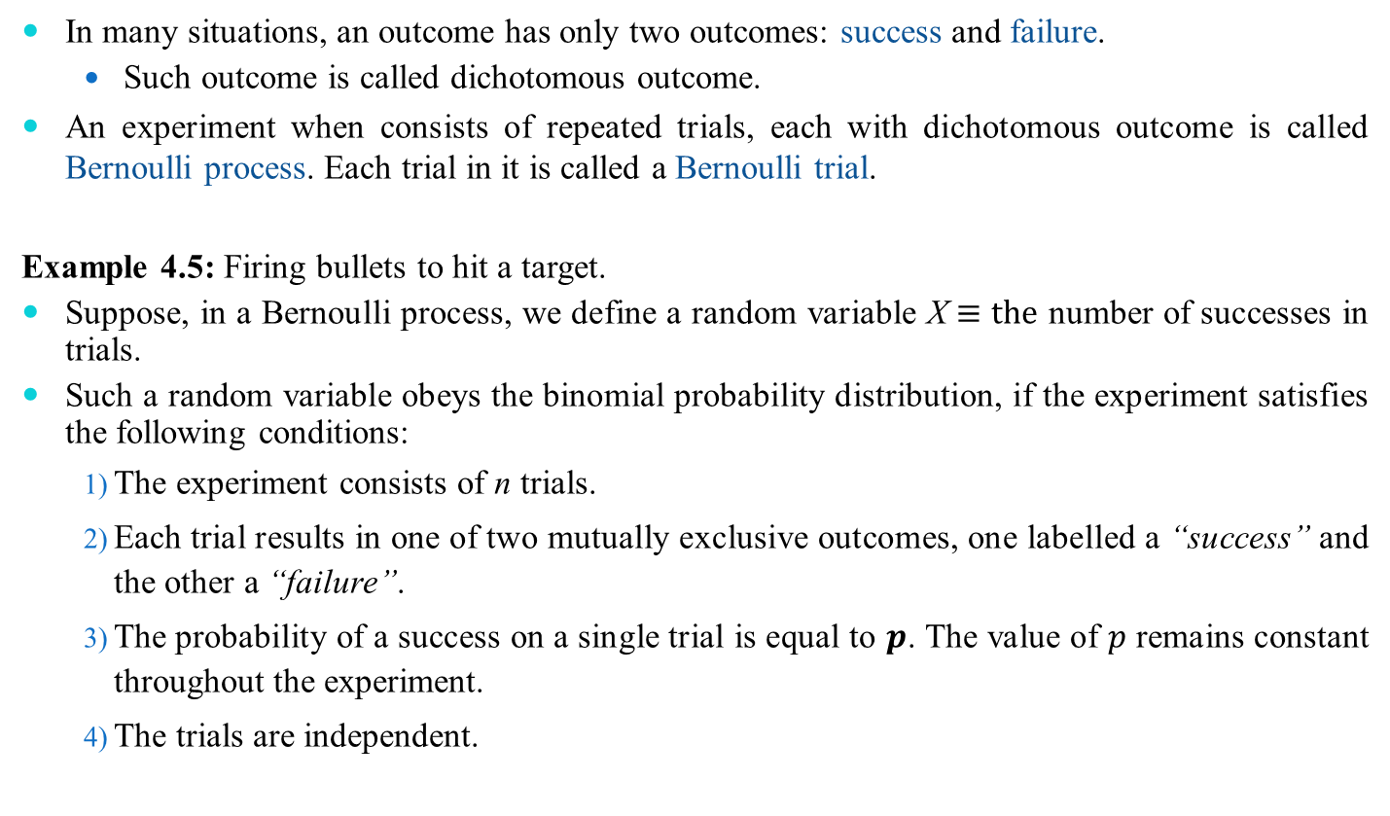
Binomial Distribution
In many situations, an outcome has only two outcomes: success and failure.
Such outcome is called dichotomous outcome.
An experiment when consists of repeated trials, each with dichotomous outcome is called Bernoulli process. Each trial in it is called a Bernoulli trial.
Example 4.5: Firing bullets to hit a target.
Suppose, in a Bernoulli process, we define a random variable X$≡the$ number of successes in trials.
Such a random variable obeys the binomial probability distribution, if the experiment satisfies the following conditions:
The experiment consists of n trials.
Each trial results in one of two mutually exclusive outcomes, one labelled a “success” and the other a “failure”.
The probability of a success on a single trial is equal to $p$. The value of $p$ remains constant throughout the experiment.
The trials are independent.

Slide 16
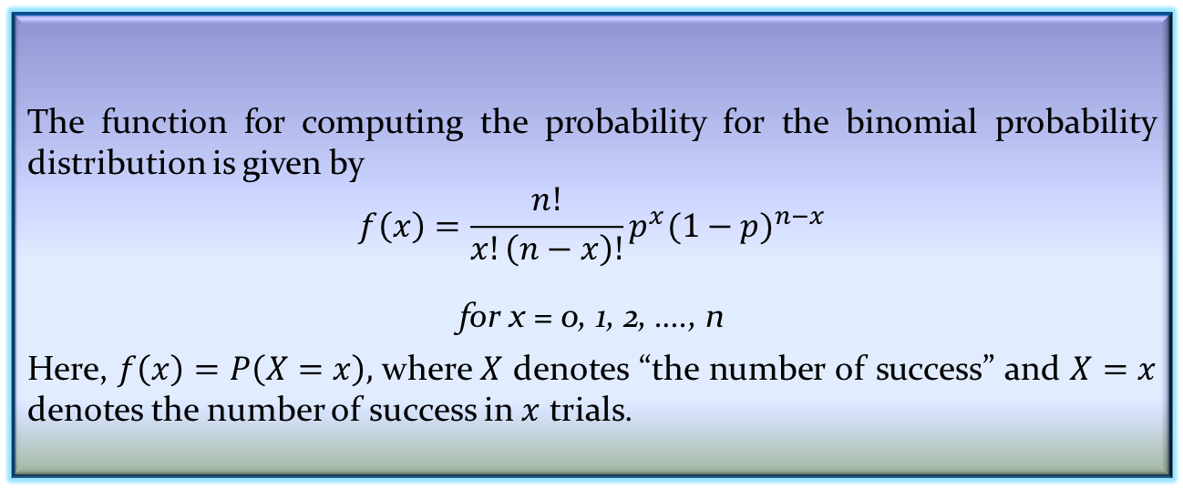
Defining Binomial Distribution
Definition 4.3: Binomial distribution
The function for computing the probability for the binomial probability distribution is given by
$$f\left(x\right)=\frac{n!}{x!\left(n−x\right)!}p^{x}{(1−p)}^{n−x}$$
for x = 0, 1, 2, …., n
Here, $f\left(x\right)=P\left(X=x\right),$where $X$ denotes “the number of success” and $X=x$ denotes the number of success in $x$ trials.

Slide 17
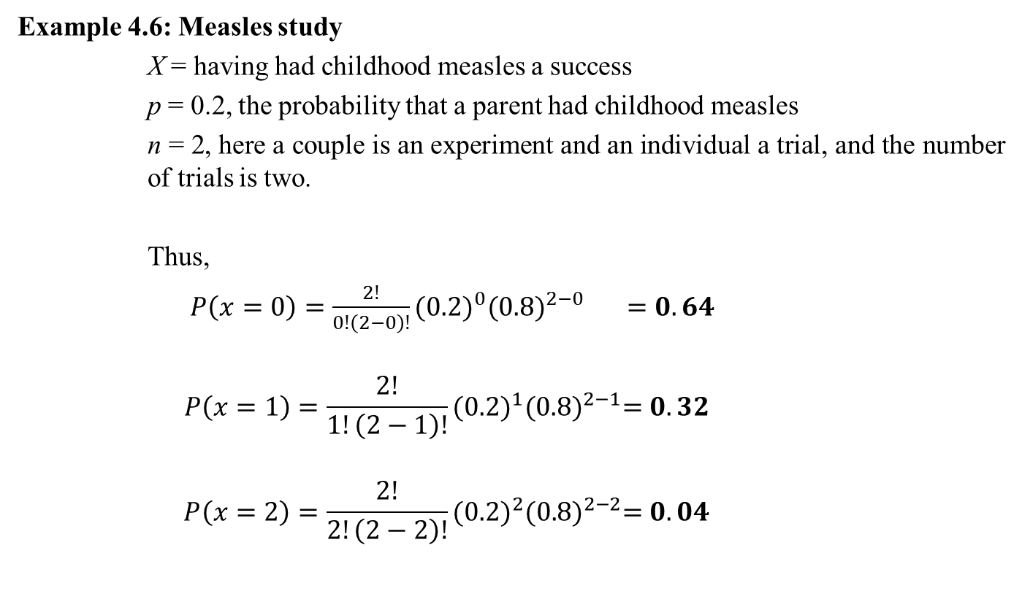
Binomial Distribution
Example 4.6: Measles study
X = having had childhood measles a success
p = 0.2, the probability that a parent had childhood measles
n = 2, here a couple is an experiment and an individual a trial, and the number of trials is two.
Thus,
$P\left(x=0\right)=\frac{2!}{0!\left(2−0\right)!}{(0.2)}^{0}{(0.8)}^{2−0} =0.64$
$$P\left(x=1\right)=\frac{2!}{1!\left(2−1\right)!}{(0.2)}^{1}{(0.8)}^{2−1}=0.32$$
$$P\left(x=2\right)=\frac{2!}{2!\left(2−2\right)!}{(0.2)}^{2}{(0.8)}^{2−2}=0.04$$

Slide 18
Binomial Distribution
Example 4.7: Martin Clothing store
The store manager wants to determine the purchase decisions of next three customers who enter the clothing store. On the basis of past experience, the store manager estimates the probability that any one customer will make a purchase is .30.
What is the probability that two of the next three customers will make a purchase?

Slide 19
Example: Martin Clothing store
Using S to denote success (a purchase) and F to denote failure (no purchase), we are interested in experimental outcomes involving two successes in the three trials.
The probability of the first two customers buying and the third customer not buying denoted by (S, S, F), is given by
(p)(p)(1 – p)
With a .30 probability of a customer buying on any one trial, the probability of the first two customers buying and the third customer not buying is
(0.3)(0.3)(1-0.3) = .063

Slide 20
Two other experimental outcomes result in two success and one failure. The probabilities for all three experimental outcomes involving two successes follow:
Experimental
outcome Probability
(S, S, F) .063
(S, F, S) .063
(F, S, S) .063

Slide 21
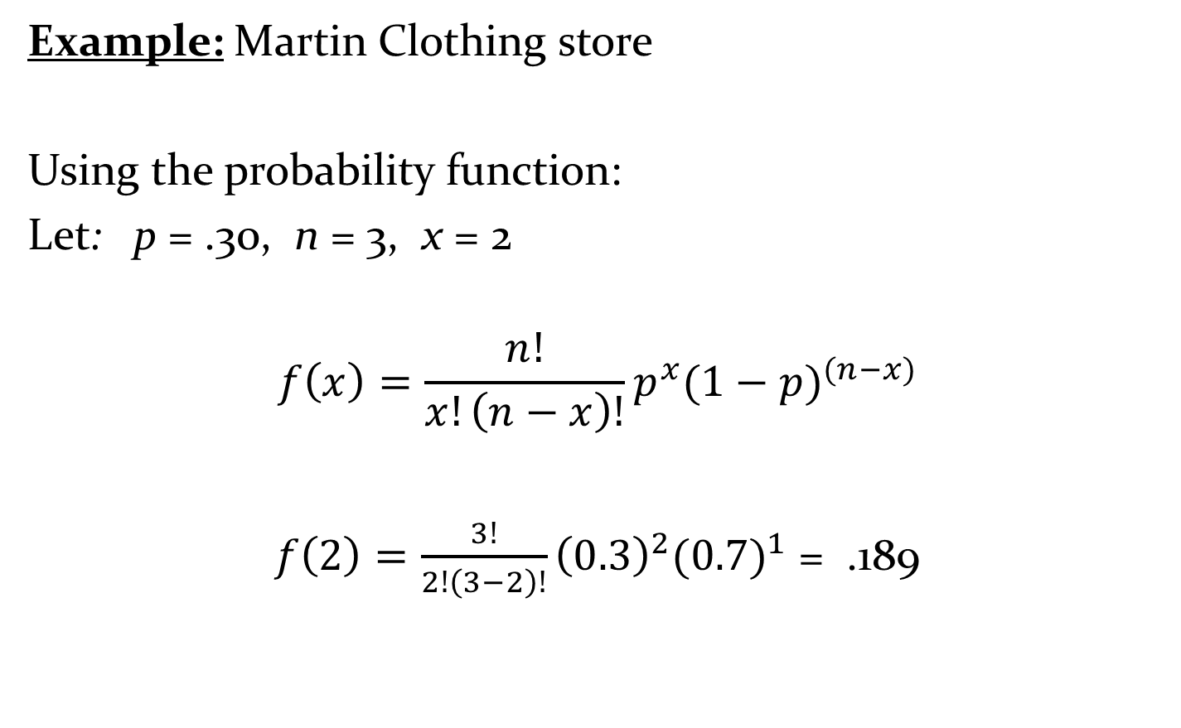
Example: Martin Clothing store
Using the probability function:
Let: p = .30, n = 3, x = 2
$$f\left(x\right)=\frac{n!}{x!\left(n−x\right)!}p^{x}(1−p)^{(n−x)}$$
$f\left(2\right)=\frac{3!}{2!\left(3−2\right)!}{\left(0.3\right)}^{2}(0.7)^{1}$ = .189

Slide 22
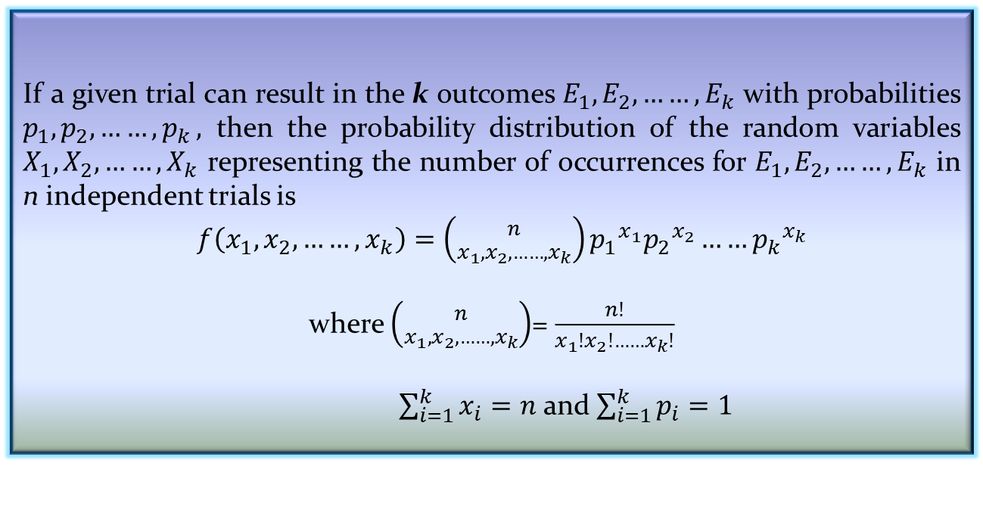
The Multinomial Distribution
The binomial experiment becomes a multinomial experiment, if we let each trial has more than two possible outcome.
If a given trial can result in the k outcomes $E_{1}, E_{2}, ……,E_{k}$ with probabilities $p_{1}, p_{2}, ……{,p}_{k},$ then the probability distribution of the random variables $X_{1}, X_{2}, ……{,X}_{k}$ representing the number of occurrences for $E_{1}, E_{2}, ……,E_{k}$ in n independent trials is
$f\left(x_{1}, x_{2}, ……,x_{k}\right)=\left({n \atop x_{1}, x_{2}, ……,x_{k}}\right){p_{1}}^{x_{1}}{p_{2}}^{x_{2}}……{p_{k}}^{x_{k}}$
where $\left({n \atop x_{1}, x_{2}, ……,x_{k}}\right)$= $\frac{n!}{x_{1}!x_{2}!……x_{k}!}$
$\sum_{i=1}^{k}{x_{i}=n}$ and $\sum_{i=1}^{k}{p_{i}=1}$
Definition 4.4: Multinomial distribution

Slide 23
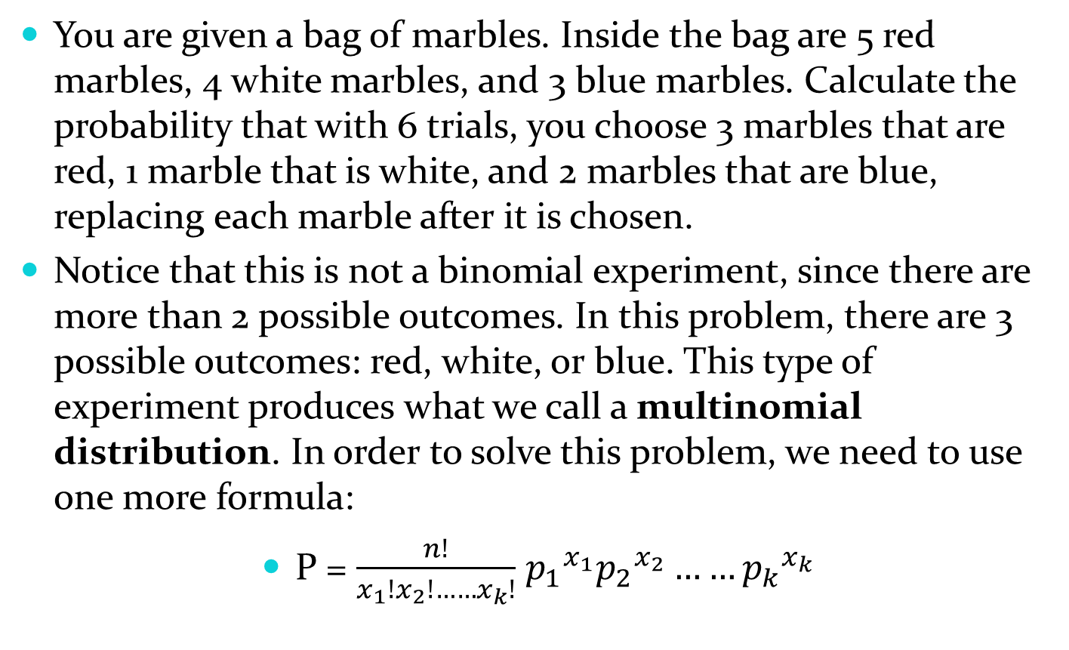
Example 4.8
You are given a bag of marbles. Inside the bag are 5 red marbles, 4 white marbles, and 3 blue marbles. Calculate the probability that with 6 trials, you choose 3 marbles that are red, 1 marble that is white, and 2 marbles that are blue, replacing each marble after it is chosen.
Notice that this is not a binomial experiment, since there are more than 2 possible outcomes. In this problem, there are 3 possible outcomes: red, white, or blue. This type of experiment produces what we call a multinomial distribution. In order to solve this problem, we need to use one more formula:
P = $\frac{n!}{x_{1}!x_{2}!……x_{k}!}$ ${p_{1}}^{x_{1}}{p_{2}}^{x_{2}}……{p_{k}}^{x_{k}}$

Slide 24
where:
n is the number of trials.
p is the probability for each possible outcome.
k is the number of possible outcomes.
Notice that in this example, k equals 3. If we had only red marbles and white marbles, k would be equal to 2, and we would have a binomial distribution.
The probability of choosing 3 red marbles, 1 white marble, and 2 blue marbles in exactly 6 picks is calculated as follows:
n=6 (6 picks)
p1 =5/12=0.416 (probability of choosing a red marble)
p2=4/12=0.333 (probability of choosing a white marble)
p3=3/12=0.25 (probability of choosing a blue marble)
n1 =3 (3 red marbles chosen)
n2 =1 (1 white marble chosen)
n3 =2 (2 blue marbles chosen) k =3 (3 possibilities)

Slide 25
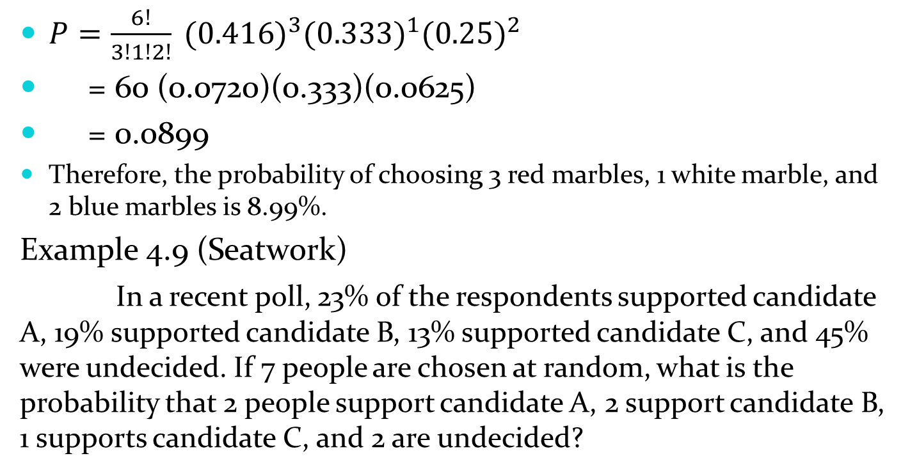
$P=\frac{6!}{3!1!2!} {(0.416)}^{3}{(0.333)}^{1}{(0.25)}^{2}$
= 60 (0.0720)(0.333)(0.0625)
= 0.0899
Therefore, the probability of choosing 3 red marbles, 1 white marble, and 2 blue marbles is 8.99%.
Example 4.9 (Seatwork)
In a recent poll, 23% of the respondents supported candidate A, 19% supported candidate B, 13% supported candidate C, and 45% were undecided. If 7 people are chosen at random, what is the probability that 2 people support candidate A, 2 support candidate B, 1 supports candidate C, and 2 are undecided?

Slide 26
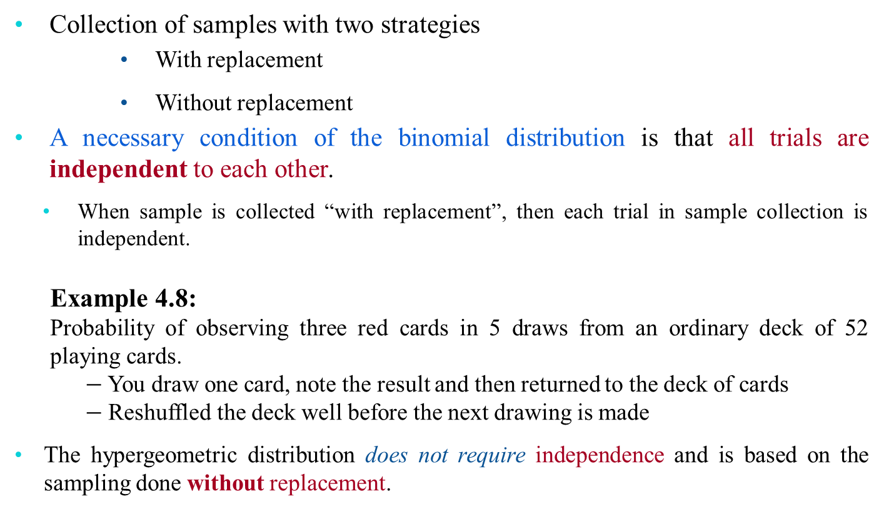
The Hypergeometric Distribution
Collection of samples with two strategies
With replacement
Without replacement
A necessary condition of the binomial distribution is that all trials are independent to each other.
When sample is collected “with replacement”, then each trial in sample collection is independent.
Example 4.8:
Probability of observing three red cards in 5 draws from an ordinary deck of 52 playing cards.
$−$You draw one card, note the result and then returned to the deck of cards
$−$ Reshuffled the deck well before the next drawing is made
The hypergeometric distribution does not require independence and is based on the sampling done without replacement.

Slide 27
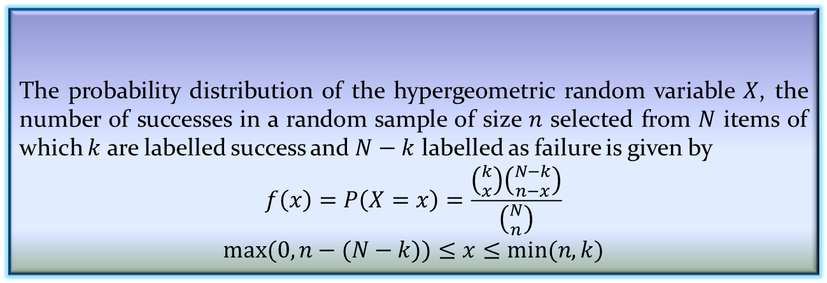

The Hypergeometric Distribution
In general, the hypergeometric probability distribution enables us to find the probability of selecting $x$ successes in $n$ trials from $N$ items.
Properties of Hypergeometric Distribution
A random sample of size $n$ is selected without replacement from $N$ items.
$k$ of the $N$ items may be classified as success and $N−k$ items are classified as failure.
Let $X$ denotes a hypergeometric random variable defining the number of successes.
Definition 4.5: Hypergeometric Probability Distribution
The probability distribution of the hypergeometric random variable $X$, the number of successes in a random sample of size $n$ selected from $N$ items of which $k$ are labelled success and $N−k$ labelled as failure is given by
$$f\left(x\right)=P\left(X=x\right)=\frac{\left({k \atop x}\right)\left({N−k \atop n−x}\right)}{\left({N \atop n}\right)}$$
$$max⁡(0, n−(N−k))≤x≤min⁡(n,k)$$

Slide 28
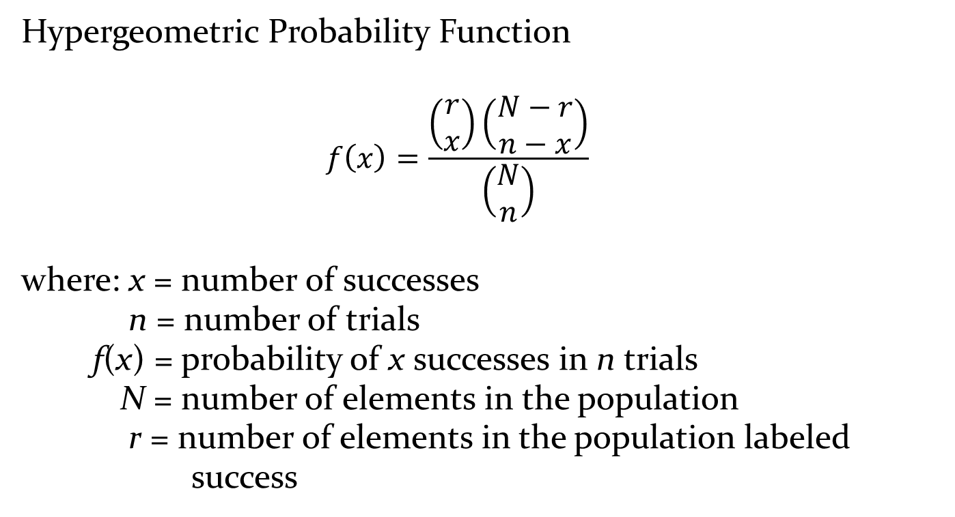
Hypergeometric Probability Distribution
Hypergeometric Probability Function
$$f\left(x\right)=\frac{\left(\begin{matrix}r \\ x\end{matrix}\right)\left(\begin{matrix}N−r \\ n−x\end{matrix}\right)}{\left(\begin{matrix}N \\ n\end{matrix}\right)}$$
where: x = number of successes
n = number of trials
f(x) = probability of x successes in n trials
N = number of elements in the population
r = number of elements in the population labeled
success

Slide 29

Hypergeometric Probability Distribution
Hypergeometric Probability Function
$f\left(x\right)=\frac{\left(\begin{matrix}r \\ x\end{matrix}\right)\left(\begin{matrix}N−r \\ n−x\end{matrix}\right)}{\left(\begin{matrix}N \\ n\end{matrix}\right)}$ for 0 < x < r
number of ways
x successes can be selected
from a total of r successes
in the population
number of ways n – x failures can be selected
from a total of N – r failures
in the population
number of ways
n elements can be selected
from a population of size N

Slide 30
Hypergeometric Probability Distribution
Hypergeometric Probability Function
The probability function f(x) on the previous slide is usually applicable for values of x = 0, 1, 2, … n.
However, only following values of x are valid:
1) x < r and
2) n – x < N – r
If these two conditions do not hold for a value of x, the corresponding f(x) equals 0.

Slide 31
Hypergeometric Probability Distribution
Example: Ontario electric
Electric fuses produced by Ontario electric are packaged in boxes of 12 each. Suppose an inspector randomly selects 3 of the 12 fuses in a box for testing. If the box contains 5 defective fuses, what is the probability that the inspector will find exactly one of the three fuses defective?

Slide 32
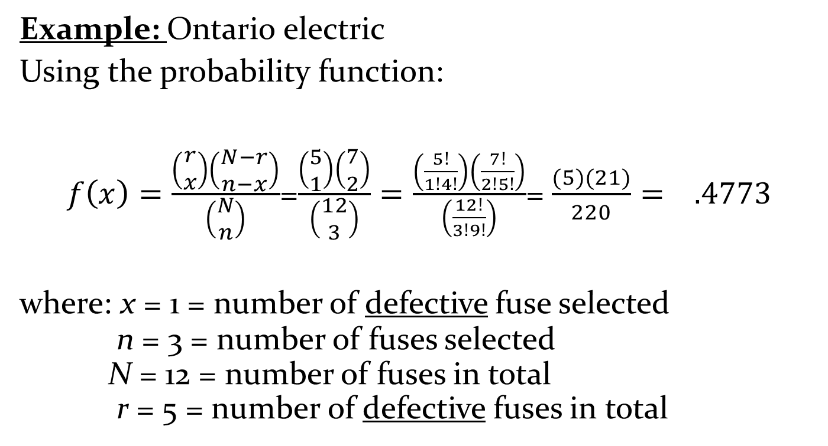
Hypergeometric Probability Distribution
Example: Ontario electric
Using the probability function:
$f\left(x\right)=\frac{\left(\begin{matrix}r \\ x\end{matrix}\right)\left(\begin{matrix}N−r \\ n−x\end{matrix}\right)}{\left(\begin{matrix}N \\ n\end{matrix}\right)}$=$\frac{\left(\begin{matrix}5 \\ 1\end{matrix}\right)\left(\begin{matrix}7 \\ 2\end{matrix}\right)}{\left(\begin{matrix}12 \\ 3\end{matrix}\right)}=\frac{\left(\frac{5!}{1!4!}\right)\left(\frac{7!}{2!5!}\right)}{\left(\frac{12!}{3!9!}\right)}$= $\frac{(5)(21)}{220}= .4773$
where: x = 1 = number of defective fuse selected
n = 3 = number of fuses selected
N = 12 = number of fuses in total
r = 5 = number of defective fuses in total

Slide 33
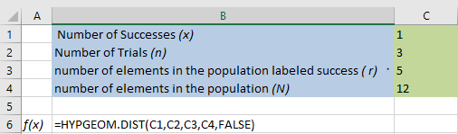
Using excel to compute Hypergeometric probabilities
Excel Formula Worksheet

Slide 34
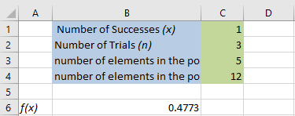
Using excel to compute Hypergeometric probabilities
Excel Value Worksheet

Slide 35


A deck of cards contains 20 cards: 6 red cards and 14 black cards. 5 cards are drawn randomly without replacement. What is the probability that exactly 4 red cards are drawn?
The probability of choosing exactly 4 red cards is:
P(4 red cards) = $\frac{\text{\# }\text{samples} \text{with}\text{ 4 }\text{red} \text{cards} \text{and}\text{ 1 }\text{black} \text{card}}{\text{\# }\text{of} \text{possible}\text{ 5 }\text{card} \text{samples} }$

Slide 36
A small voting district has 101 female voters and 95 male voters. A random sample of 10 voters is drawn. What is the probability exactly 7 of the voters will be female?
Answers: 0.0135; 0.130

Slide 37
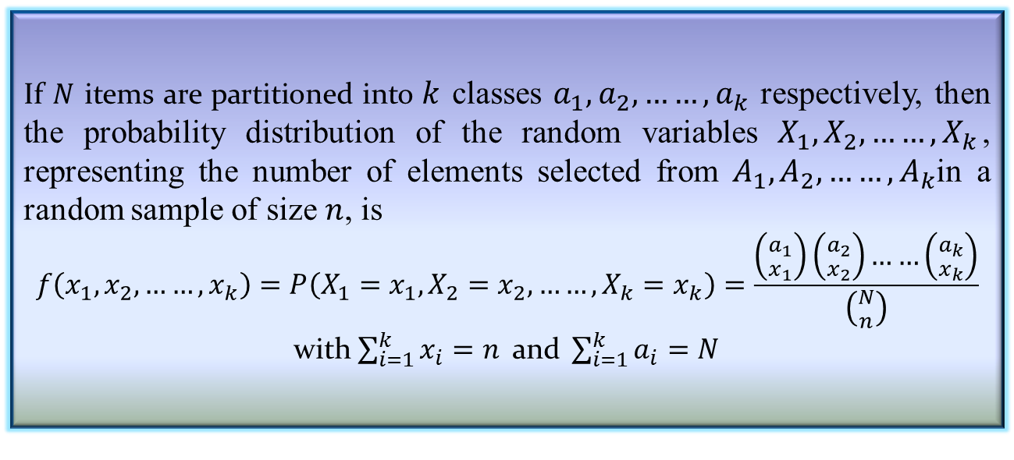
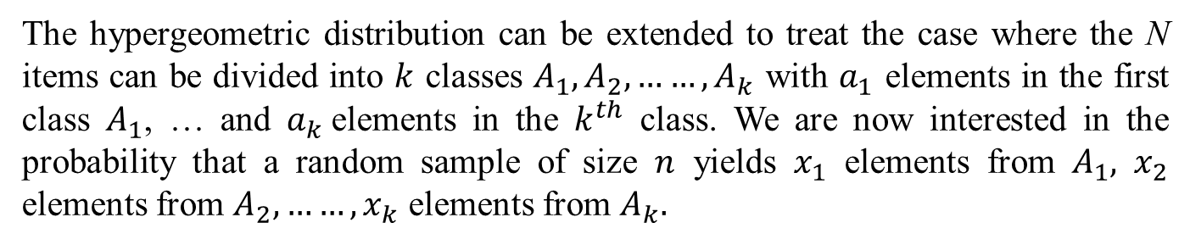
Multivariate Hypergeometric Distribution
The hypergeometric distribution can be extended to treat the case where the N items can be divided into $k$ classes $A_{1}, A_{2}, ……,A_{k}$ with $a_{1}$ elements in the first class $A_{1}$, … and $a_{k}$elements in the $k^{th}$ class. We are now interested in the probability that a random sample of size $n$ yields $x_{1}$ elements from $A_{1},$ $x_{2}$ elements from $A_{2},……,x_{k}$ elements from $A_{k}.$
Definition 4.6: Multivariate Hypergeometric Distribution
If $N$ items are partitioned into $k$ classes $a_{1}, a_{2}, ……,a_{k}$ respectively, then the probability distribution of the random variables $X_{1}, X_{2}, ……,X_{k}$, representing the number of elements selected from $A_{1}, A_{2}, ……,A_{k}$in a random sample of size $n$, is
$$f\left(x_{1}, x_{2}, ……,x_{k}\right)=P\left(X_{1}=x_{1},X_{2}=x_{2}, ……,X_{k}=x_{k}\right)=\frac{\left({a_{1} \atop x_{1}}\right)\left({a_{2} \atop x_{2}}\right)……\left({a_{k} \atop x_{k}}\right)}{\left({N \atop n}\right)}$$
with $\sum_{i=1}^{k}{x_{i}=n} \text{and} \sum_{i=1}^{k}{a_{i}=N}$

Slide 38
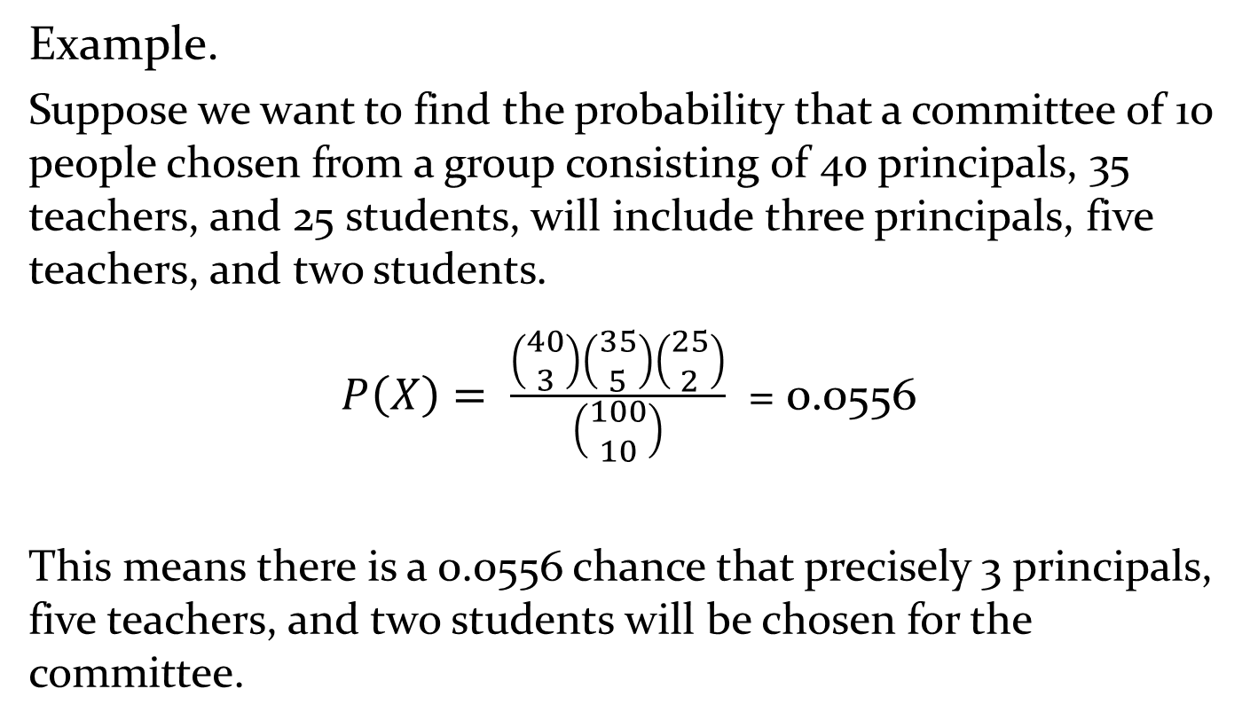
Multivariate Hypergeometric
Example.
Suppose we want to find the probability that a committee of 10 people chosen from a group consisting of 40 principals, 35 teachers, and 25 students, will include three principals, five teachers, and two students.
$P\left(X\right)= \frac{\left(\begin{matrix}40 \\ 3\end{matrix}\right)\left(\begin{matrix}35 \\ 5\end{matrix}\right)\left(\begin{matrix}25 \\ 2\end{matrix}\right)}{\left(\begin{matrix}100 \\ 10\end{matrix}\right)}$ = 0.0556
This means there is a 0.0556 chance that precisely 3 principals, five teachers, and two students will be chosen for the committee.

Slide 39

The Poisson Distribution
There are some experiments, which involve the occurring of the number of outcomes during a given time interval (or in a region of space).
Such a process is called Poisson process.
Example :
Number of clients visiting a ticket selling counter in a metro station.

Slide 40
Poisson Probability Distribution
More Examples and Applications
Number of vehicles arriving at a toll booth in one hour
Number of leaks in 100 miles of pipeline
Number of persons lining up on an ATM booth during pay day
Number of typhoons in a year in the country
birth defects and genetic mutations
rare diseases (like Leukemia, but not AIDS because it is infectious and so not independent) - especially in legal cases
car accidents
traffic flow and ideal gap distance
number of typing errors on a page
hairs found in McDonald's hamburgers
spread of an endangered animal in Africa
failure of a machine in one month

Slide 41
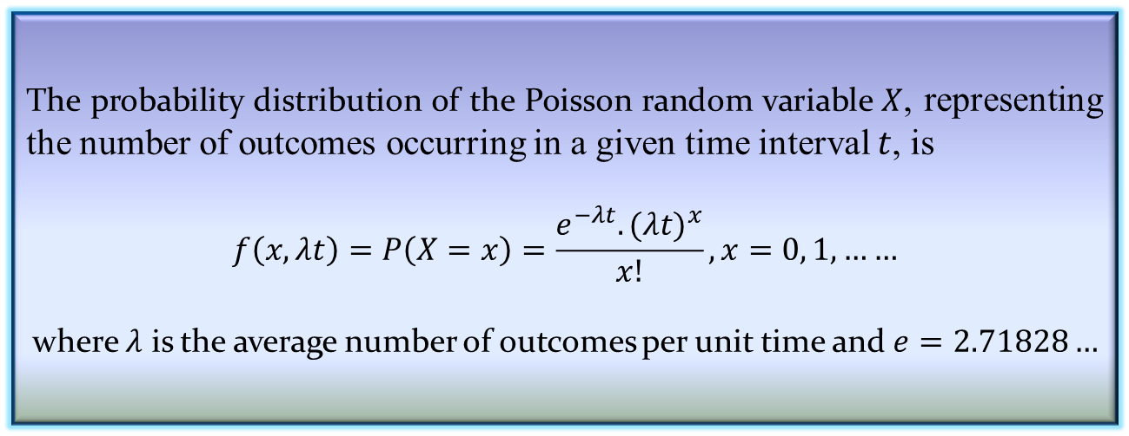
The Poisson Distribution
Properties of Poisson process
The number of outcomes in one time interval is independent of the number that occurs in any other disjoint interval [Poisson process has no memory]
The probability that a single outcome will occur during a very short interval is proportional to the length of the time interval and does not depend on the number of outcomes occurring outside this time interval.
The probability that more than one outcome will occur in such a short time interval is negligible.
Definition 4.7: Poisson distribution
The probability distribution of the Poisson random variable $X$, representing the number of outcomes occurring in a given time interval $t$, is
$$f\left(x,λt\right)=P\left(X=x\right)=\frac{e^{−λt}.{(λt)}^{x}}{x!}, x=0, 1,……$$
where $λ$ is the average number of outcomes per unit time and $e=2.71828…$

Slide 42
Poisson Probability Distribution
Example: Arrivals at the drive-up teller window of a bank
The average number of cars arriving at the drive-up teller window of a bank in a 15 –minute period of time on weekday mornings is 10.
What is the probability of 5 arrivals in a 15-minute period of time on a weekday morning?

Slide 43
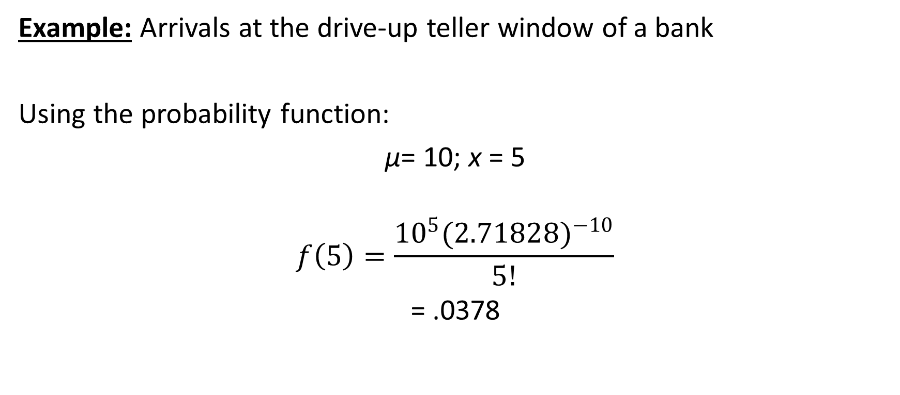
Poisson Probability Distribution
Example: Arrivals at the drive-up teller window of a bank
Using the probability function:
µ= 10; x = 5
$$f\left(5\right)=\frac{{10}^{5}(2.71828)^{−10}}{5!}$$
= .0378

Slide 44
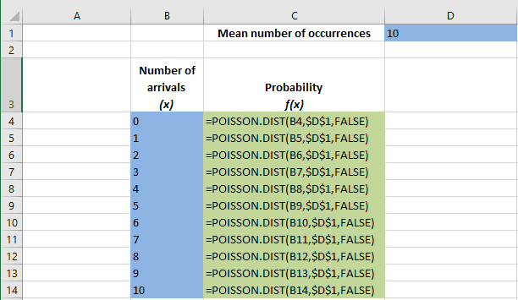
Using Excel to Compute Poisson Probabilities
Excel Formula worksheet

Slide 45
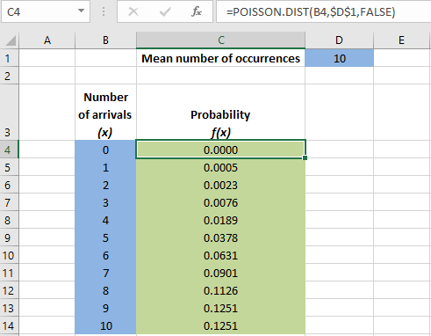
Using Excel to Compute Poisson Probabilities
Excel Value Worksheet

Slide 46
Poisson Distribution Example
A life insurance salesman sells on the average 3 life insurance policies per week. Use Poisson's law to calculate the probability that in a given week he will sell
Some policies
2 or more policies but less 5 policies.
Assuming that there are 5 working days per week, what is the probability that in a given day he will sell one policy?

Slide 47
Descriptive measures
Given a random variable X in an experiment, we have denoted $f\left(x\right)=P\left(X=x\right),$ the probability that $X=x$. For discrete events $f\left(x\right)=0$ for all values of $x$ except $x=0, 1, 2,…..$
Properties of discrete probability distribution
$0≤f(x)≤1$
$\sum{f\left(x\right)=1}$
$μ=\sum{x.f(x)}$ [ is the mean ]
$σ^{2}= \sum{{\left(x−μ\right)}^{2}}.f(x)$ [ is the variance ]
In $2, 3 and 4,$summation is extended for all possible discrete values of $x$.
Note: For discrete uniform distribution, $f\left(x\right)=\frac{1}{n}$ with $x=1, 2, ……,n$
$$μ=\frac{1}{n}\sum_{i=1}^{n}{x_{i}}$$
and ${σ }^{2}=\frac{1}{n}\sum_{i=1}^{n}{{{(x}_{i}−μ)}^{2}}$

Slide 48
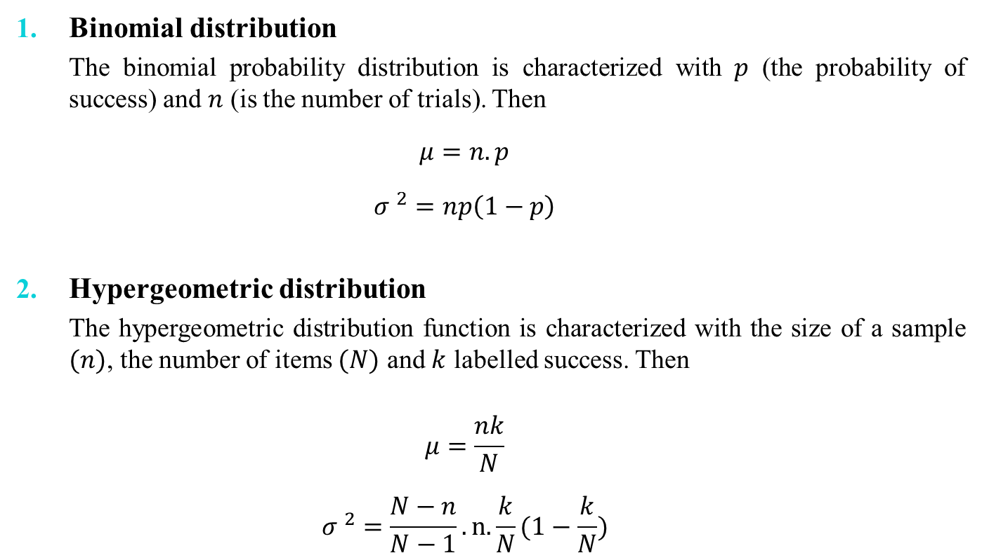
Descriptive measures
Binomial distribution
The binomial probability distribution is characterized with $p$ (the probability of success) and $n$ (is the number of trials). Then
$$μ=n.p$$
$${σ }^{2}=np\left(1−p\right)$$
Hypergeometric distribution
The hypergeometric distribution function is characterized with the size of a sample $(n)$, the number of items $(N)$ and $k$ labelled success. Then
$$μ=\frac{nk}{N}$$
$${σ }^{2}=\frac{N−n}{N−1}.n.\frac{k}{N}(1−\frac{k}{N})$$

Slide 49

Descriptive measures
Poisson Distribution
The Poisson distribution is characterized with $λt$ where $λ=the mean of outcomes$ and $t=time interval$.
$$μ=λt$$
$${σ }^{2}=λt$$

Slide 50
Continuous Probability Distributions

Slide 51
Continuous Probability Distributions

Slide 52
Continuous Probability Distributions
When the random variable of interest can take any value in an interval, it is called continuous random variable.
Every continuous random variable has an infinite, uncountable number of possible values (i.e., any value in an interval)
Consequently, continuous random variable differs from discrete random variable.

Slide 53
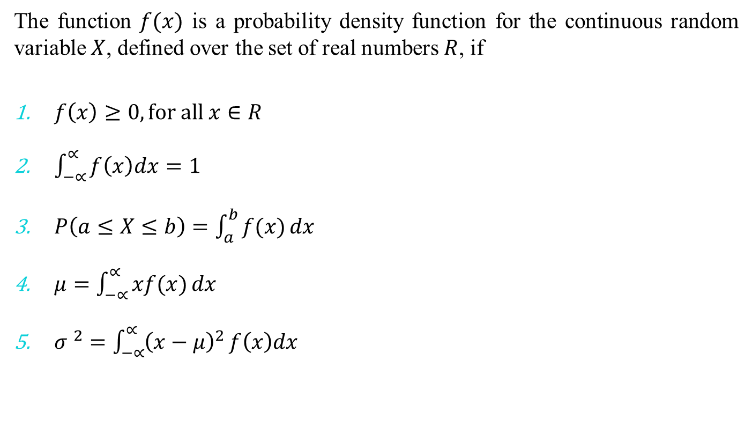
Properties of Probability Density Function
The function $f(x)$ is a probability density function for the continuous random variable $X$, defined over the set of real numbers $R$, if
$f\left(x\right)≥0, for all x∈R$
$\int_{−∝}^{∝}{f\left(x\right)dx}=1$
$P\left(a≤X≤b\right)=\int_{a}^{b}{f(x)}dx$
$μ=\int_{−∝}^{∝}{xf(x)}dx$
${σ }^{2}=\int_{−∝}^{∝}{{\left(x−μ\right)}^{2}}f\left(x\right)dx$

Slide 54
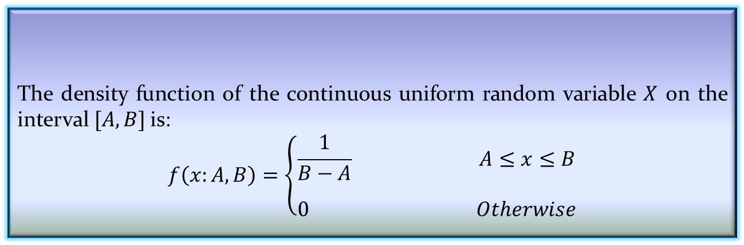
Continuous Uniform Distribution
One of the simplest continuous distribution in all of statistics is the continuous uniform distribution.
The density function of the continuous uniform random variable $X$ on the interval $[A,B]$is:
$$f\left(x:A,B\right)=\left\{\begin{aligned}\frac{1}{B−A} A≤x≤B \\ \\ 0 Otherwise\end{aligned}\right.$$
Definition 4.8: Continuous Uniform Distribution

Slide 55

Continuous Uniform Distribution
Note:
$\int_{−∞}^{∞}{f\left(x\right)dx=\frac{1}{B−A}×(B−A)}=1$
$P(c<x<d$)=$\frac{d−c}{B−A}$ where both $c$ and $d$ are in the interval (A,B)
$μ=\frac{A+B}{2}$
$σ^{2}=\frac{{(B−A)}^{2}}{12}$

Slide 56
Normal Distribution
The most often used continuous probability distribution is the normal distribution; it is also known as Gaussian distribution.
Its graph called the normal curve is the bell-shaped curve.
Such a curve approximately describes many phenomenon occur in nature, industry and research.
Physical measurement in areas such as meteorological experiments, rainfall studies and measurement of manufacturing parts are often more than adequately explained with normal distribution.
A continuous random variable X having the bell-shaped distribution is called a normal random variable.

Slide 57
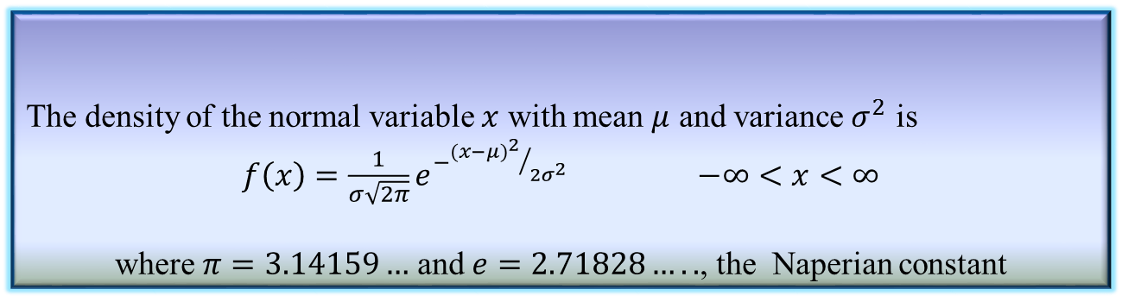
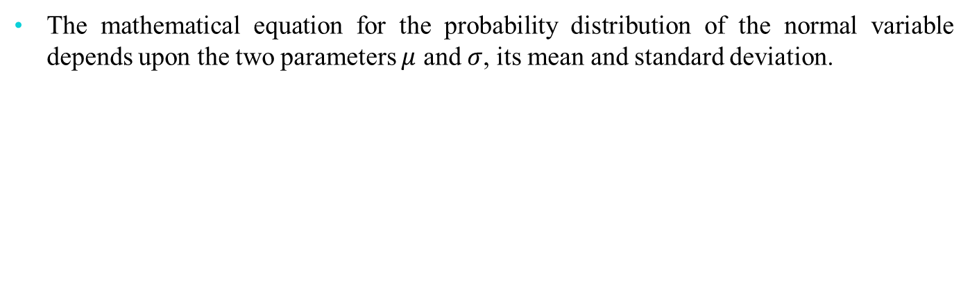
Normal Distribution
The mathematical equation for the probability distribution of the normal variable depends upon the two parameters $μ$ and $σ$, its mean and standard deviation.
Definition 4.9: Normal distribution
The density of the normal variable $x$ with mean $μ$ and variance $σ^{2}$ is
$f\left(x\right)=\frac{1}{σ\sqrt{2π}}e^{−{{(x−μ)}^{2}}/{2σ^{2}}}$ $−∞<x<∞$
where $π=3.14159…$ and $e=2.71828…..$, the Naperian constant

Slide 58
Normal Distribution

Slide 59
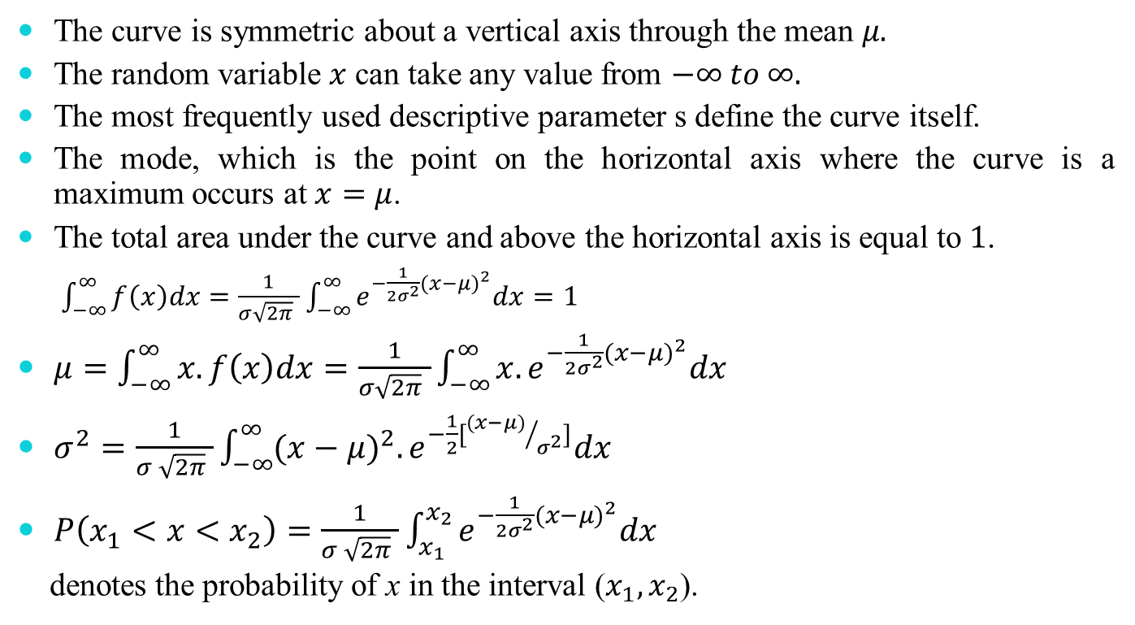
Properties of Normal Distribution
The curve is symmetric about a vertical axis through the mean $μ.$
The random variable $x$ can take any value from $−∞ to ∞.$
The most frequently used descriptive parameter s define the curve itself.
The mode, which is the point on the horizontal axis where the curve is a maximum occurs at $x=μ$.
The total area under the curve and above the horizontal axis is equal to $1$.
$\int_{−∞}^{∞}{f\left(x\right)dx=\frac{1}{σ\sqrt{2π} }\int_{−∞}^{∞}{e^{−\frac{1}{2σ^{2}}{(x−μ)}^{2}}dx}}=1$
$μ=\int_{−∞}^{∞}{x.f\left(x\right)dx=\frac{1}{σ\sqrt{2π} }\int_{−∞}^{∞}{x.e^{−\frac{1}{2σ^{2}}{(x−μ)}^{2}}dx}}$
$σ^{2}=\frac{1}{σ \sqrt{2π} }\int_{−∞}^{∞}{{(x−μ)}^{2}.e^{−\frac{1}{2}[{(x−μ)}/{σ^{2}}]}dx}$
$P\left(x_{1}<x<x_{2}\right)=\frac{1}{σ \sqrt{2π} }\int_{x_{1}}^{x_{2}}{e^{−\frac{1}{2σ^{2}}{(x−μ)}^{2}}dx}$
denotes the probability of x in the interval ($x_{1},x_{2}$).

Slide 60
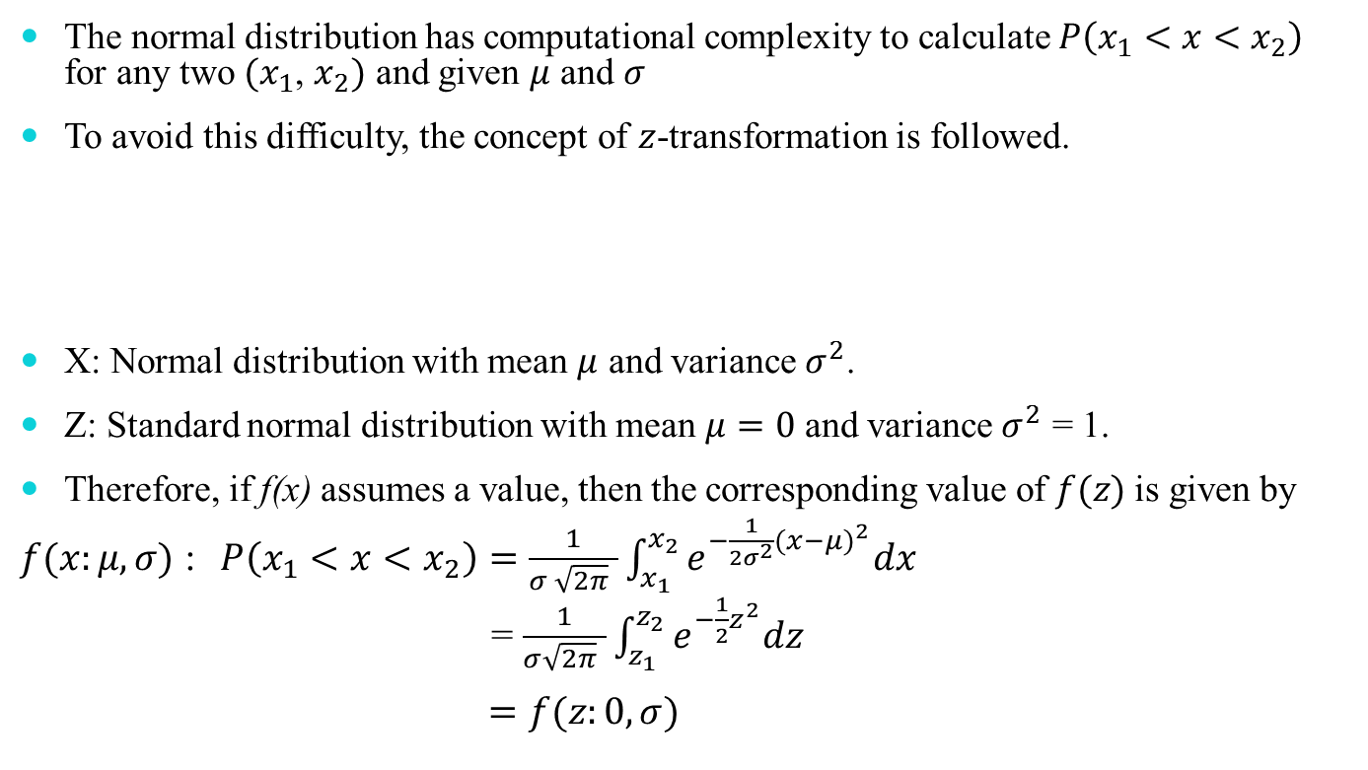
Standard Normal Distribution
The normal distribution has computational complexity to calculate $P\left(x_{1}<x<x_{2}\right)$ for any two ${(x}_{1}$, $x_{2})$ and given $μ$ and $σ$
To avoid this difficulty, the concept of $z$-transformation is followed.
X: Normal distribution with mean $μ$ and variance $σ^{2}$.
Z: Standard normal distribution with mean $μ=0$ and variance $σ^{2}$ = 1.
Therefore, if f(x) assumes a value, then the corresponding value of $f(z)$is given by
$f(x:μ,σ)$ : $P\left(x_{1}<x<x_{2}\right)=\frac{1}{σ \sqrt{2π} }\int_{x_{1}}^{x_{2}}{e^{−\frac{1}{2σ^{2}}{(x−μ)}^{2}}dx}$
= $\frac{1}{σ\sqrt{2π} }\int_{z_{1}}^{z_{2}}{e^{−\frac{1}{2}z^{2}}dz}$
$=f(z:0,σ)$
$z=\frac{x−μ}{σ}$ [Z-transformation]

Slide 61
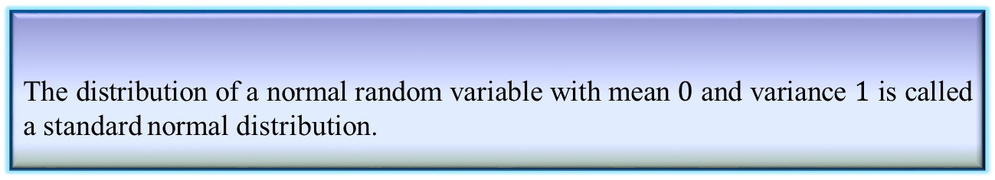
Standard Normal Distribution
Definition 4.10: Standard normal distribution
The distribution of a normal random variable with mean $0$ and variance $1$ is called a standard normal distribution.

Slide 62
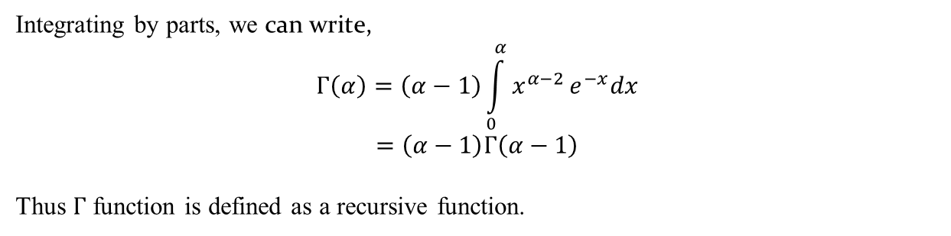

Gamma Distribution
The gamma distribution derives its name from the well known gamma function in mathematics.
Definition 4.11: Gamma Function
$Γ\left(α\right)=\int_{0}^{α}{x^{α−1}}e^{−x}dx$ for $α>0$
Integrating by parts, we can write,
$$Γ\left(α\right)=\left(α−1\right)\int_{0}^{α}{x^{α−2}}e^{−x}dx$$
$$=\left(α−1\right)Γ\left(α−1\right)$$
Thus $Γ$ function is defined as a recursive function.

Slide 63

Gamma Distribution
When $α=n$, we can write,
$Γ\left(n\right)=\left(n−1\right)\left(n−2\right)……….Γ(1)$
$$=\left(n−1\right)\left(n−2\right)……….3.2.1$$
$=\left(n−1\right)$!
Further, $Γ\left(1\right)=\int_{0}^{∞}{e^{−x}dx}=1$
Note:
$Γ\left(\frac{1}{2}\right)=\sqrt{π}$ [An important property]

Slide 64
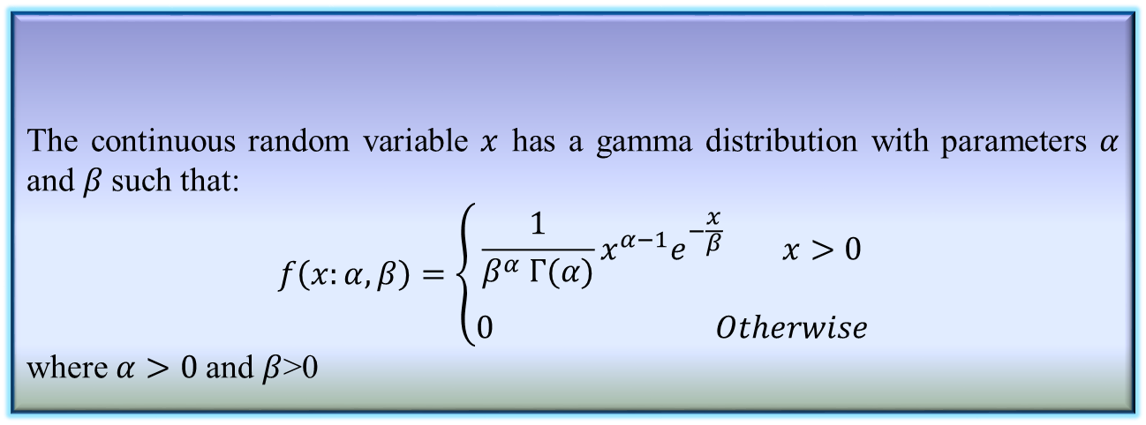
Gamma Distribution
The continuous random variable $x$ has a gamma distribution with parameters $α$ and $β$such that:
$$f\left(x:α,β\right)=\left\{\begin{aligned}\frac{1}{β^{α} Γ(α)}x^{α−1}e^{−\frac{x}{β}} x>0 \\ \\ 0 Otherwise\end{aligned}\right.$$
where $α>0$and $β$>0
Definition 4.12: Gamma Distribution

Slide 65
Applications of Gamma Distribution
The gamma distribution can be used a range of disciplines including queuing models, climatology, and financial services. Examples of events that may be modeled by gamma distribution include: The amount of rainfall accumulated in a reservoir. The size of loan defaults or aggregate insurance claims.

Slide 66
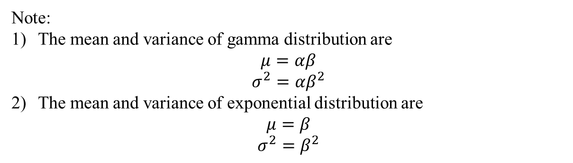
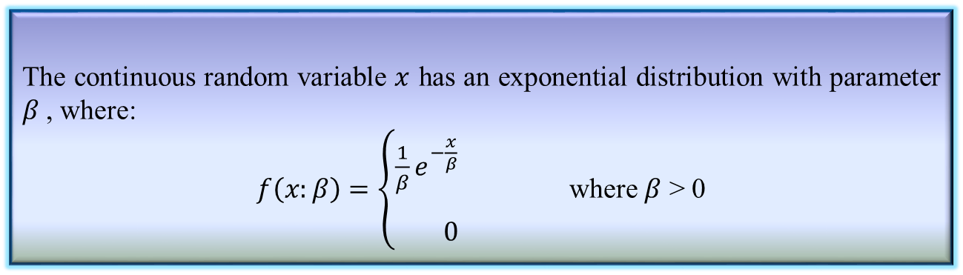
Exponential Distribution
Definition 4.13: Exponential Distribution
The continuous random variable $x$ has an exponential distribution with parameter $β$, where:
$f\left(x:β\right)=\left\{\begin{aligned}\frac{1}{β}e^{−\frac{x}{β}} \\ \\ 0\end{aligned}\right.$ where $β$ > 0
Note:
The mean and variance of gamma distribution are
$$μ=αβ$$
$$σ^{2}=αβ^{2}$$
The mean and variance of exponential distribution are
$$μ=β$$
$$σ^{2}=β^{2}$$

Slide 67
Exponential Distribution Example
For example, the amount of time (beginning now) until an earthquake occurs has an exponential distribution. Other examples include the length, in minutes, of long distance business telephone calls, and the amount of time, in months, a car battery lasts.

Slide 68
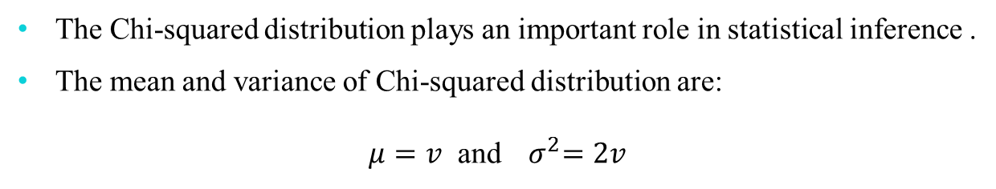
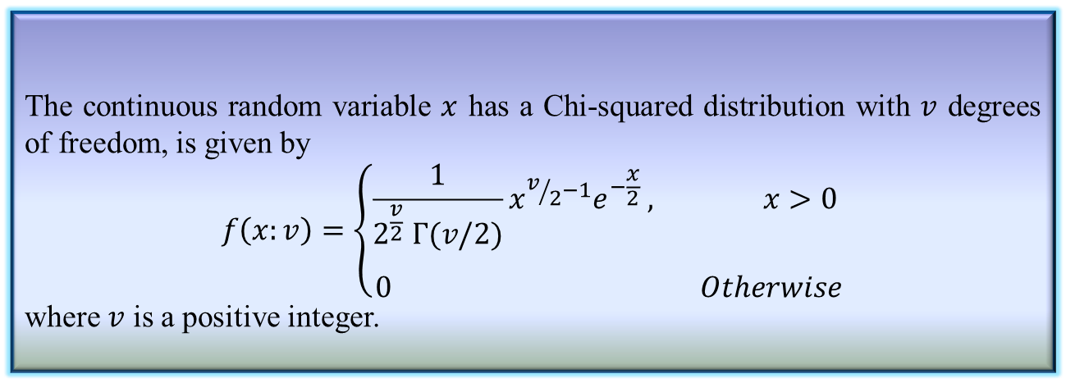
Chi-Squared Distribution
Definition 4.14: Chi-squared distribution
The continuous random variable $x$ has a Chi-squared distribution with $v$ degrees of freedom, is given by
$$f\left(x:v\right)=\left\{\begin{aligned}\frac{1}{2^{\frac{v}{2}} Γ(v/2)}{x^{v/2−1}e}^{−\frac{x}{2}} , x>0 \\ \\ 0 Otherwise\end{aligned}\right.$$
where $v$ is a positive integer.
The Chi-squared distribution plays an important role in statistical inference .
The mean and variance of Chi-squared distribution are:
$μ=v$ and${ σ}^{2}=2v$

Slide 69
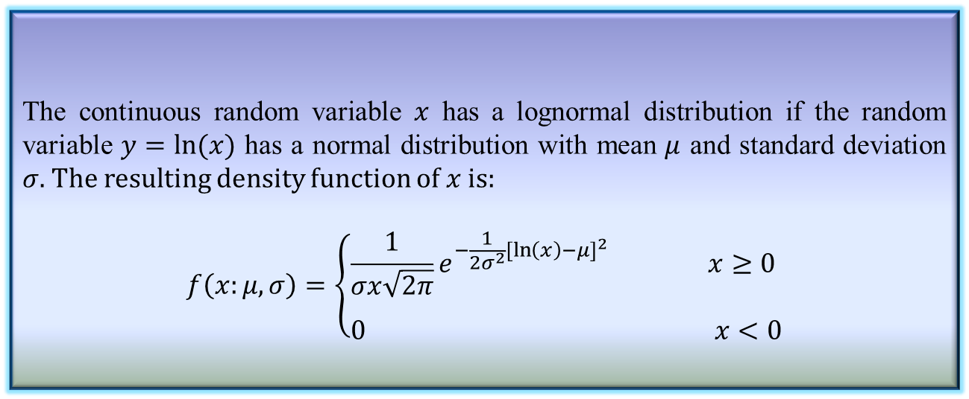
Lognormal Distribution
The lognormal distribution applies in cases where a natural log transformation results in a normal distribution.
Definition 4.15: Lognormal distribution
The continuous random variable $x$ has a lognormal distribution if the random variable $y=ln⁡(x)$ has a normal distribution with mean $μ$ and standard deviation $σ.$ The resulting density function of $x$ is:
$$f\left(x:μ,σ\right)=\left\{\begin{aligned}\frac{1}{σx\sqrt{2π}}e^{−\frac{1}{2σ^{2}}{[\ln\left(x\right)−μ]}^{2}} x≥0 \\ \\ 0 x<0\end{aligned}\right.$$

Slide 70
Lognormal Distribution

Slide 71
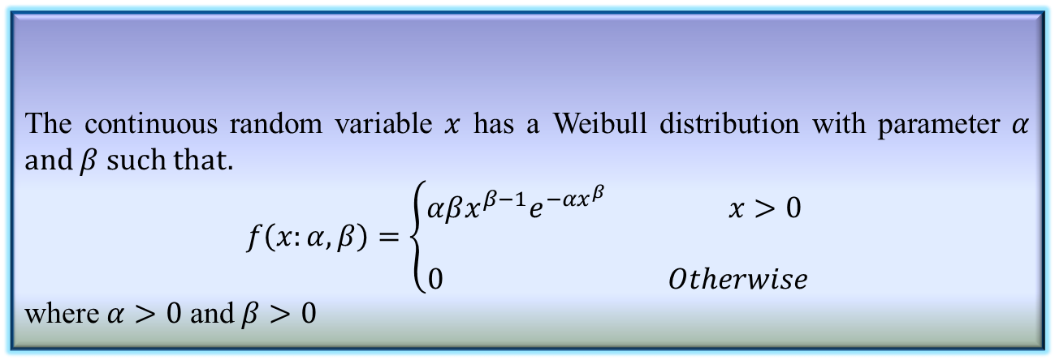
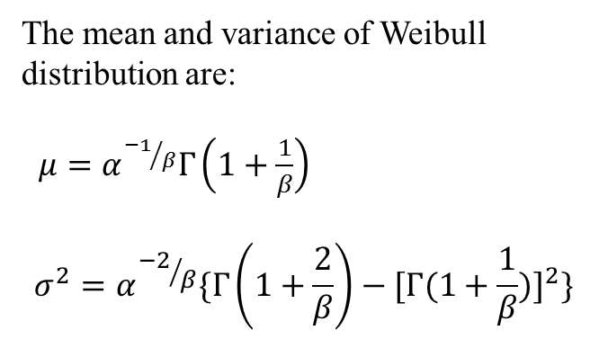
Weibull Distribution
Definition 4.16: Weibull Distribution
The continuous random variable $x$ has a Weibull distribution with parameter $α$ and $β$ such that.
$$f\left(x:α,β\right)=\left\{\begin{aligned}αβx^{β−1}e^{−αx^{β}} x>0 \\ \\ 0 Otherwise\end{aligned}\right.$$
where $α>0$ and $β>0$
The mean and variance of Weibull distribution are:
$μ=α^{{−1}/β}Γ\left(1+\frac{1}{β}\right)$
$$σ^{2}=α^{{−2}/β}\{Γ\left(1+\frac{2}{β}\right)−{[Γ(1+\frac{1}{β})]}^{2}\}$$

Slide 72
The Weibull distribution is a continuous probability distribution named after Swedish mathematician Waloddi Weibull. He originally proposed the distribution as a model for material breaking strength, but recognized the potential of the distribution in his 1951 paper A Statistical Distribution Function of Wide Applicability. Today, it’s commonly used to assess product reliability, analyze life data and model failure times. The Weibull can also fit a wide range of data from many other fields, including: biology, economics, engineering sciences, and hydrology (Rinne, 2008).

Slide 73
Weibull Distribution Applications
Weibull analysis involves using the Weibull distribution (and sometimes, the lognormal) to study life data analysis — the analysis of time to failure. For example, Weibull analysis can be used to study:
Lifetimes of medical and dental implants,
Components produced in a factory (like bearings, capacitors, or dialetrics),
Warranty analysis,
Utility services,
Other areas where time-to-failure is important.

Slide 74
Reference
The detail material related to this lecture can be found in
Probability and Statistics for Enginneers and Scientists (8th Ed.) by Ronald E. Walpole, Sharon L. Myers, Keying Ye (Pearson), 2013.

Slide 75
Any question?
You may post your question(s) at the “Discussion Forum” maintained in the course Web page!

Slide 76
Questions of the day…
Give some examples of random variables? Also, tell the range of values and whether they are with continuous or discrete values.
In the following cases, what are the probability distributions are likely to be followed. In each case, you should mention the random variable and the parameter(s) influencing the probability distribution function.
In a retail source, how many counters should be opened at a given time period.
Number of people who are suffering from cancers in a town?

Slide 77
Questions of the day…
In the following cases, what are the probability distributions are likely to be followed. In each case, you should mention the random variable and the parameter(s) influencing the probability distribution function.
A missile will hit the enemy’s aircraft.
A student in the class will secure EX grade.
Salary of a person in an enterprise.
Accident made by cars in a city.
People quit education after i) primary ii) secondary and iii) higher secondary educations.

Slide 78
Questions of the day…
How you can calculate the mean and standard deviation of a population if the population follows the following probability distribution functions with respect to an event.
Binomial distribution function.
Poisson’s distribution function.
Hypergeometric distribution function.
Normal distribution function.
Standard normal distribution function.

